Slide 1

Alexandre Corcia
Aritz Errazkin
Eric Parra

Slide 2
High Concept
Evander is a rushing 2D hack and slash platformer, where the player will need to master his time and space traveling newly discovered abilities in order to advance through upcoming difficulties.

Slide 3
BackStory
You gain control over Roman’s Golden Era gladiator Evander, in his quest to dethrone Janus, the god who locked his memories behind the Doors of Past.
His only weapons will be his newly discovered time traveling powers and his ability to dash into his targets which combined with his gladiator skills will make him the fearest threat to the Olympos.

Slide 4
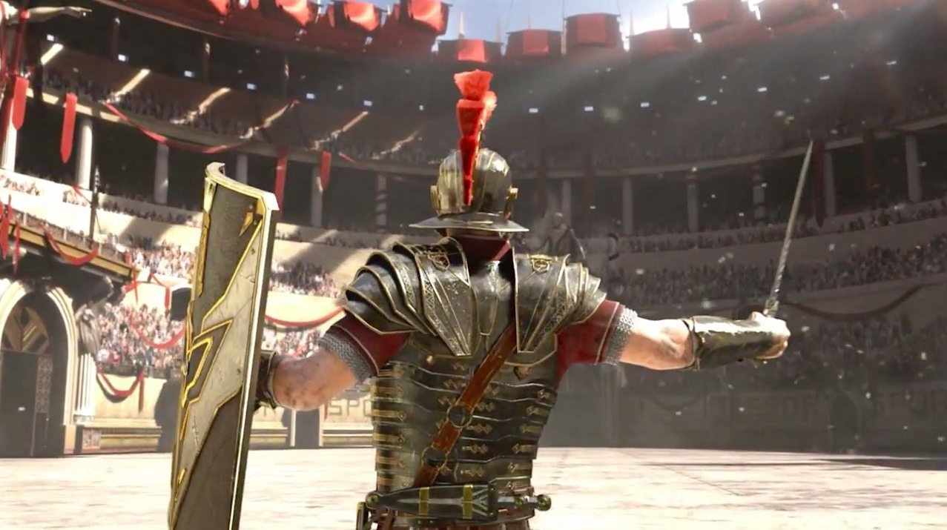
Multi Level
Burst into ancient Roma’s most iconic places.
Fight different enemys to reach the pantheon, the temple of the gods, to summon Janus and recall your past.
Remember gladiators’ lifelong oath: “Glory or Death!”

Slide 5
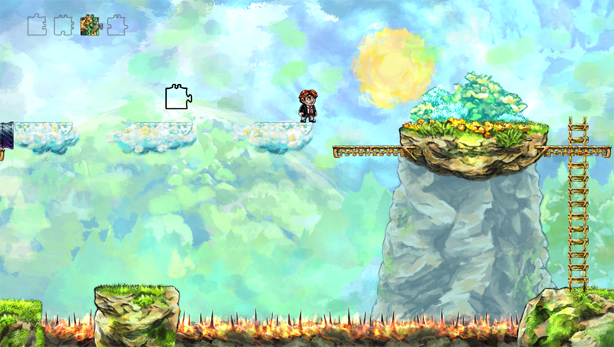
Core Mechanics
2D Platformer WASD movement. Run and Jump throug levels.
W
A
D
S

Slide 6
Core mechanics
Dash into the enemies to start frenetic battles!
Select your nearest target by presing space and teleport with the space bar to finish him!
Time travel is no more a thing of the future!
Travel as back as two seconds holding Q pressed to protect from enemies and recover life! But be careful, time is difficult to manage…

Slide 7
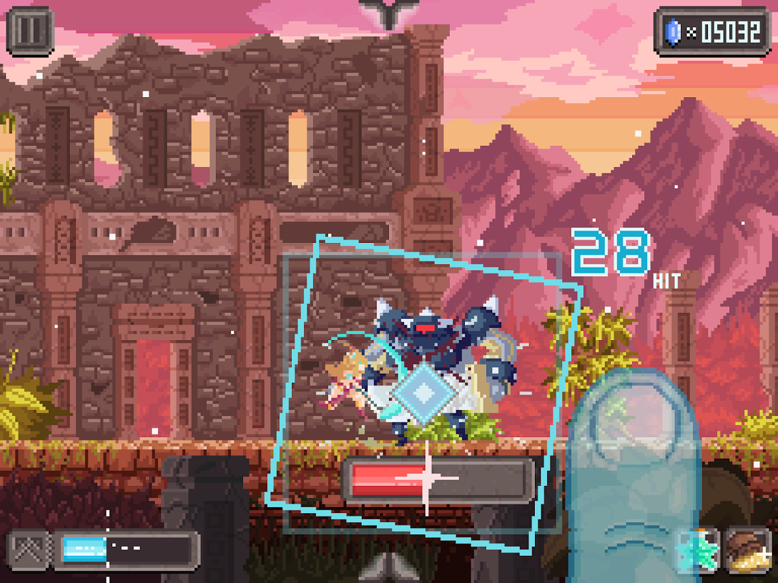
Attack, attack and attack
Obliterate enemies rapidly to set incredible combos and boost your score making a good use of the dash!
Evander is real quick, so quick you’ll travell back in time to avoid obstacless rather than defend from hazards.

Slide 8
Fight your way to the olympos
In your journey you will face tons of enemys send by the gods:
Crush gods’ minions and demonstrate who’s in charge!
Stand up against demigods, the sons of the divinities who erased your memory.
Engage in epic battles against gods and get your sit in the pantheon!

Slide 9

Beware of time
Time is unpredictable, but always serves the bravest warriors, be sure to demonstrate it!
Cutting edge time refilling bar system! Stringing beats give you time, earn as much time as posible to travel as far back as two seconds!
Don’t misspend time, you might need it to advance through some levels.

Slide 10
BackGrounds
Evander will be a journey through our protagonists life, he will rush through Rome’s streets, Colosseum, Parthenon and the sorrounding forests. But only failure will draw the limits of his quest!
As we get through levels enemies will get harder and time spawns will be shorter. We recommend discretion to nervous people as levels get frenetic!

Slide 11
Questions?
References:
Gladiator image: Rise sons of Rome, Crytek
Platform sample: Braid, Number None, Inc., Hothead Games
Combo simple: Combo Queen, Tap My Game, Inc.

